Slide 1
Software Engineering: A Practitioner’s Approach, 6/e Chapter 4 Agile Development copyright © 1996, 2001, 2005 R.S. Pressman & Associates, Inc. For University Use Only May be reproduced ONLY for student use at the university level when used in conjunction with Software Engineering: A Practitioner's Approach. Any other reproduction or use is expressly prohibited.

Slide 2
The Manifesto for Agile Software Development
“We are uncovering better ways of developing software by doing it and helping others do it. Through this work we have come to value:
Individuals and interactions over processes and tools
Working software over comprehensive documentation
Customer collaboration over contract negotiation
Responding to change over following a plan
That is, while there is value in the items on the right, we value the items on the left more.”
Kent Beck et al

Slide 3
What is “Agility”?
Effective (rapid and adaptive) response to change
Effective communication among all stakeholders
Drawing the customer onto the team
Organizing a team so that it is in control of the work performed
Yielding …
Rapid, incremental delivery of software

Slide 4
An Agile Process
Is driven by customer descriptions of what is required (scenarios)
Recognizes that plans are short-lived
Develops software iteratively with a heavy emphasis on construction activities
Delivers multiple ‘software increments’
Adapts as changes occur

Slide 5
Extreme Programming (XP)
The most widely used agile process, originally proposed by Kent Beck
XP Planning
Begins with the creation of “user stories”
Agile team assesses each story and assigns a cost
Stories are grouped to for a deliverable increment
A commitment is made on delivery date
After the first increment “project velocity” is used to help define subsequent delivery dates for other increments

Slide 6
Extreme Programming (XP)
XP Design
Follows the KIS principle
Encourage the use of CRC cards (see Chapter 8)
For difficult design problems, suggests the creation of “spike solutions”—a design prototype
Encourages “refactoring”—an iterative refinement of the internal program design
XP Coding
Recommends the construction of a unit test for a store before coding commences
Encourages “pair programming”
XP Testing
All unit tests are executed daily
“Acceptance tests” are defined by the customer and excuted to assess customer visible functionality

Slide 7
Extreme Programming (XP)

Slide 8
Adaptive Software Development
Originally proposed by Jim Highsmith
ASD — distinguishing features
Mission-driven planning
Component-based focus
Uses “time-boxing” (See Chapter 24)
Explicit consideration of risks
Emphasizes collaboration for requirements gathering
Emphasizes “learning” throughout the process

Slide 9
Adaptive Software Development
Notes:
Joint application development

Slide 10
Dynamic Systems Development Method
Promoted by the DSDM Consortium (www.dsdm.org)
DSDM—distinguishing features
Similar in most respects to XP and/or ASD
Nine guiding principles
Active user involvement is imperative.
DSDM teams must be empowered to make decisions.
The focus is on frequent delivery of products.
Fitness for business purpose is the essential criterion for acceptance of deliverables.
Iterative and incremental development is necessary to converge on an accurate business solution.
All changes during development are reversible.
Requirements are baselined at a high level
Testing is integrated throughout the life-cycle.

Slide 11
Dynamic Systems Development Method
DSDM Life Cycle (with permission of the DSDM consortium)

Slide 12
Dynamic Systems Development Method
https://vitlyoshin.com/blog/dynamic-systems-development-method/
The first phase of the DSDM process is the feasibility study.
Project viability and worthiness is determined
Project goals, objective and requirements are determined
The second phase is the business study.
understand the project’s business requirements.
Defining the project’s scope, identifying the project’s objectives, and documenting the business processes

Slide 13
Dynamic Systems Development Method (Contd.)
The third phase is the functional model iteration.
A functional model is developed, reviewed and refined through iterative development and test.
The fourth phase is the design and builds iteration.
The product or system is designed and built
The final phase is implementation.
Deployed in production environment

Slide 14
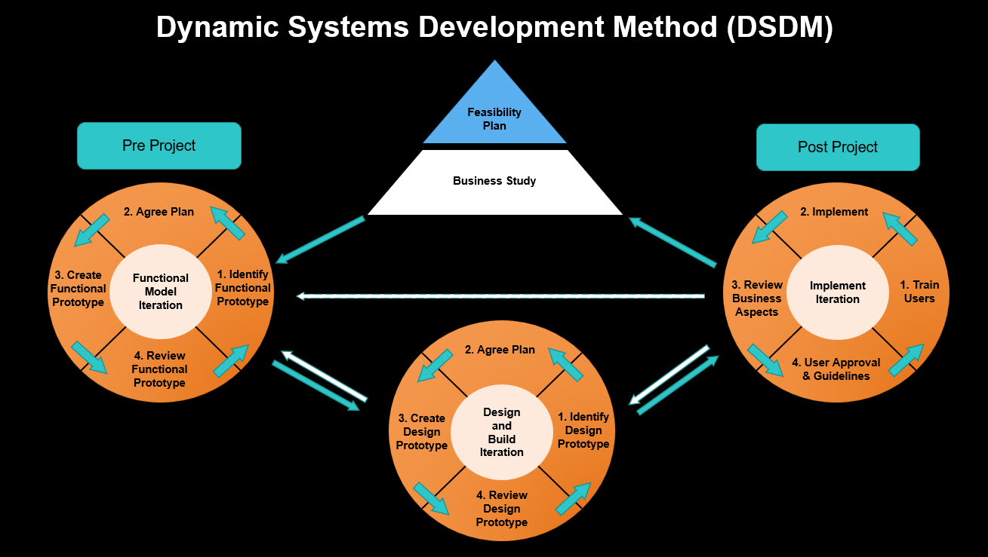
Dynamic Systems Development Method

Slide 15
Scrum
Originally proposed by Schwaber and Beedle
Scrum—distinguishing features
Development work is partitioned into “packets”
Testing and documentation are on-going as the product is constructed
Work occurs in “sprints” and is derived from a “backlog” of existing requirements
Meetings are very short and sometimes conducted without chairs
“demos” are delivered to the customer with the time-box allocated

Slide 16
Scrum

Slide 17
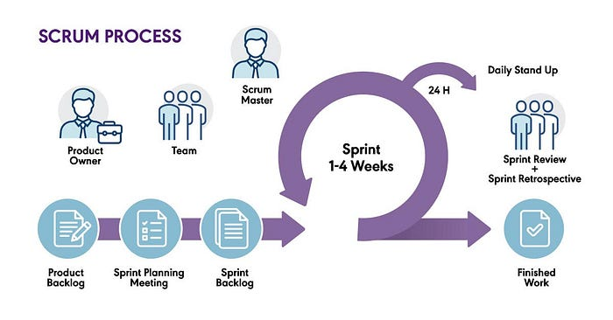
Scrum Process

Slide 18
Crystal
Proposed by Cockburn and Highsmith
Crystal—distinguishing features
Actually a family of process models that allow “maneuverability” based on problem characteristics
Face-to-face communication is emphasized
Suggests the use of “reflection workshops” to review the work habits of the team

Slide 19
Feature Driven Development
Originally proposed by Peter Coad et al
FDD—distinguishing features
Emphasis is on defining “features”
a feature “is a client-valued function that can be implemented in two weeks or less.”
Uses a feature template
<action> the <result> <by | for | of | to> a(n) <object>
A features list is created and “plan by feature” is conducted
Design and construction merge in FDD
Notes:
The template you mentioned seems to be a structure for creating sentences that describe actions and their results. It breaks down into four parts:
<action>: The verb or action being taken.
<result>: The outcome or effect of that action.
<by | for | of | to>: A preposition that connects the action and the result.
<object>: The noun or subject that is involved in the action.
For example, using this template, you might say:
"Boost the productivity by a(n) software tool."
"Increase sales for a new marketing strategy."
"Improve efficiency of a(n) team."

Slide 20
Feature Driven Development
Reprinted with permission of Peter Coad

Slide 21
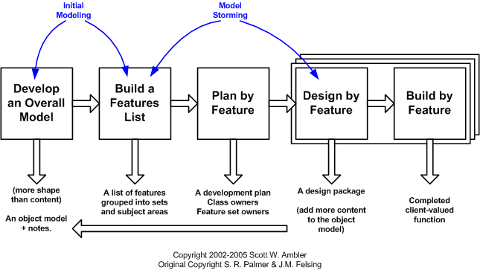
Feature Driven Development

Slide 22
Agile Modeling
Originally proposed by Scott Ambler
Suggests a set of agile modeling principles
Model with a purpose
Use multiple models
Travel light
Content is more important than representation
Know the models and the tools you use to create them
Adapt locally

Slide 23
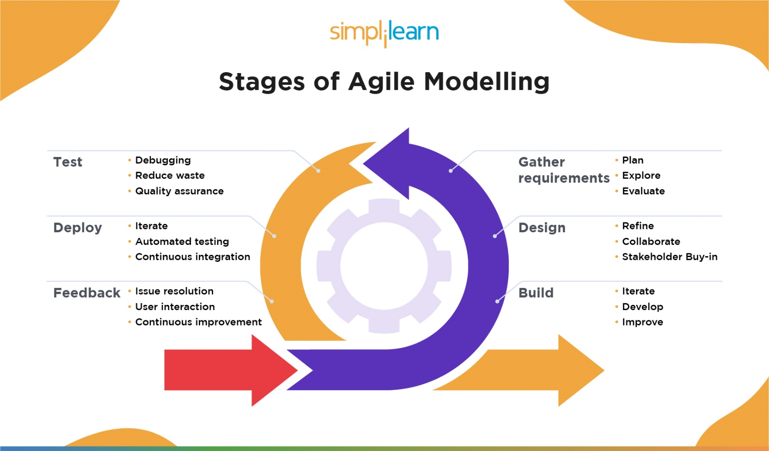
Agile Modeling

